Slide 1
Genius Hour
Project Based Learning in Primary 7

Slide 2
What is ‘Genius Hour?’
Explore your passion, pursue your purpose.
We are about to begin a very exciting new project! Taking ownership of our learning, exploring our passions and researching the big questions we ask ourselves during Genius Hour.
Genius Hour is based on Google’s 20% policy which gives employees 20% of their work time to develop their own projects. The high motivation,interest and creativity has led to many products we know and use including Gmail!
In our classroom, Genius Hour will be the time we spend each week working on our Passion Projects. This will develop our skills for life, learning and work as we investigate topics we truly care about and seek answers to our questions. We will tap into our natural curiosity as children but also develop research, organisation and planning skills along the way.
Most of this project will be completed in class but don’t be surprised if you see us working on it at home too! You can support us by asking questions and encouraging us to do the same.

Slide 3
Welcome to Genius Hour
Your project can be about anything. There are just 3 rules:
Your project must be guided by a question (what do you want to learn and why?)
Your project needs to be researched (how can you look deeply in to your topic)
Your project must be shared (will you present to the class, the school, the world?)
Explore your passion, pursue your purpose.

Slide 4
What resources can I use to research my topic?
You can use a variety of resources from newspapers and
magazines, to websites, online journals, interviews and books.

Slide 5
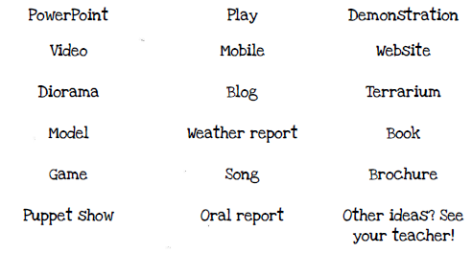
How can I share my project?

Slide 6
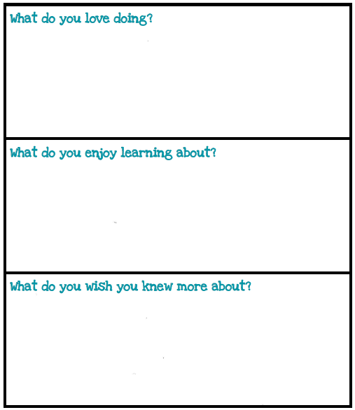
Session 1 - Brainstorming

Slide 7
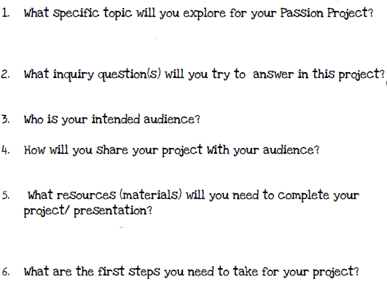
Session 2 - Your proposal
Your teacher will meet with you to discuss your proposal.
You should prepare your proposal document thinking about the following questions -

